Slide 1
Info Avengers present MAP: Movie Analytics Platform
MIS 5150: Big Data for Business
Project Deliverable 4

Slide 2

Agenda
Overview
Data Preparation
Data Flow
Sentiment Analysis
Power BI Visualization
Conclusion

Slide 3
Overview
Movie Analytics Platform
Revolutionize film data interactions
Deliver personalized movie recommendations
Deepen moviegoer engagement
Aggregated data
Internet Movie Database (IMDb)
The Movie Database (TMDB)
Large dataset
>1 million rows
42 features

Slide 4




Data Preparation
Cleaning Our Data
Downloading Raw Data
Focusing on Key Attributes
Creating New Variables
Uploading to Storage Account

Slide 5
Data Preparation
Relevant Attributes
Irrelevant Attributes
Movie Titles
Rating Data
Financial Metrics
Sentiment Data
Other Explanatory Variables
URLs
ID Numbers
Movie Status
Run Times
Ratings

Slide 6
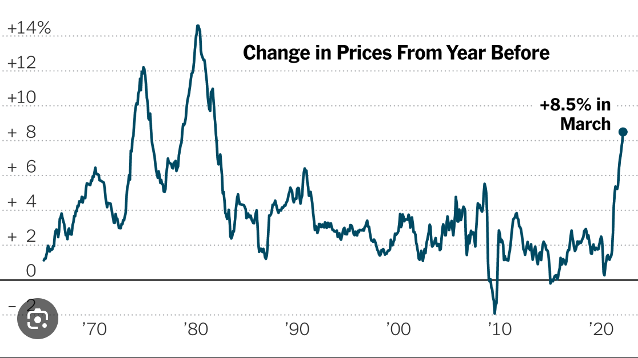
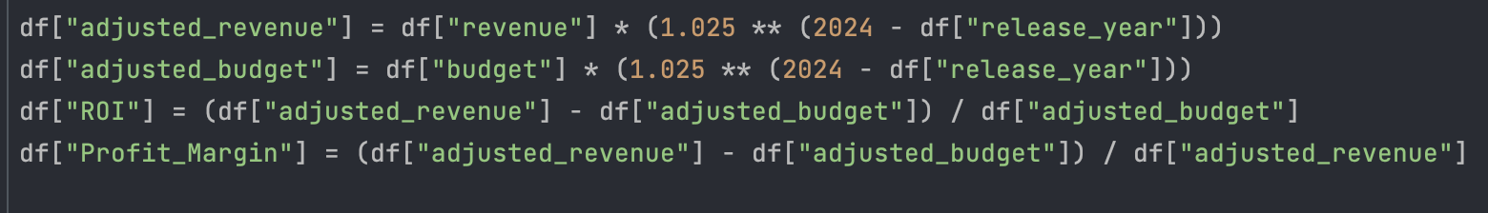
Data Preparation
Financial Analysis
Inflation Assumption: 2.5%
Adjusted Revenue / Budget
ROI & Profit Margin

Slide 7
Data Flow
Storage Account
Created a container and uploaded the Data
Data Factory
Created the Data pipelines and made Data Flow
Power BI
Storage
Account
Data Pipelines
Data Factory
Sink
Data Source
Sort

Slide 8
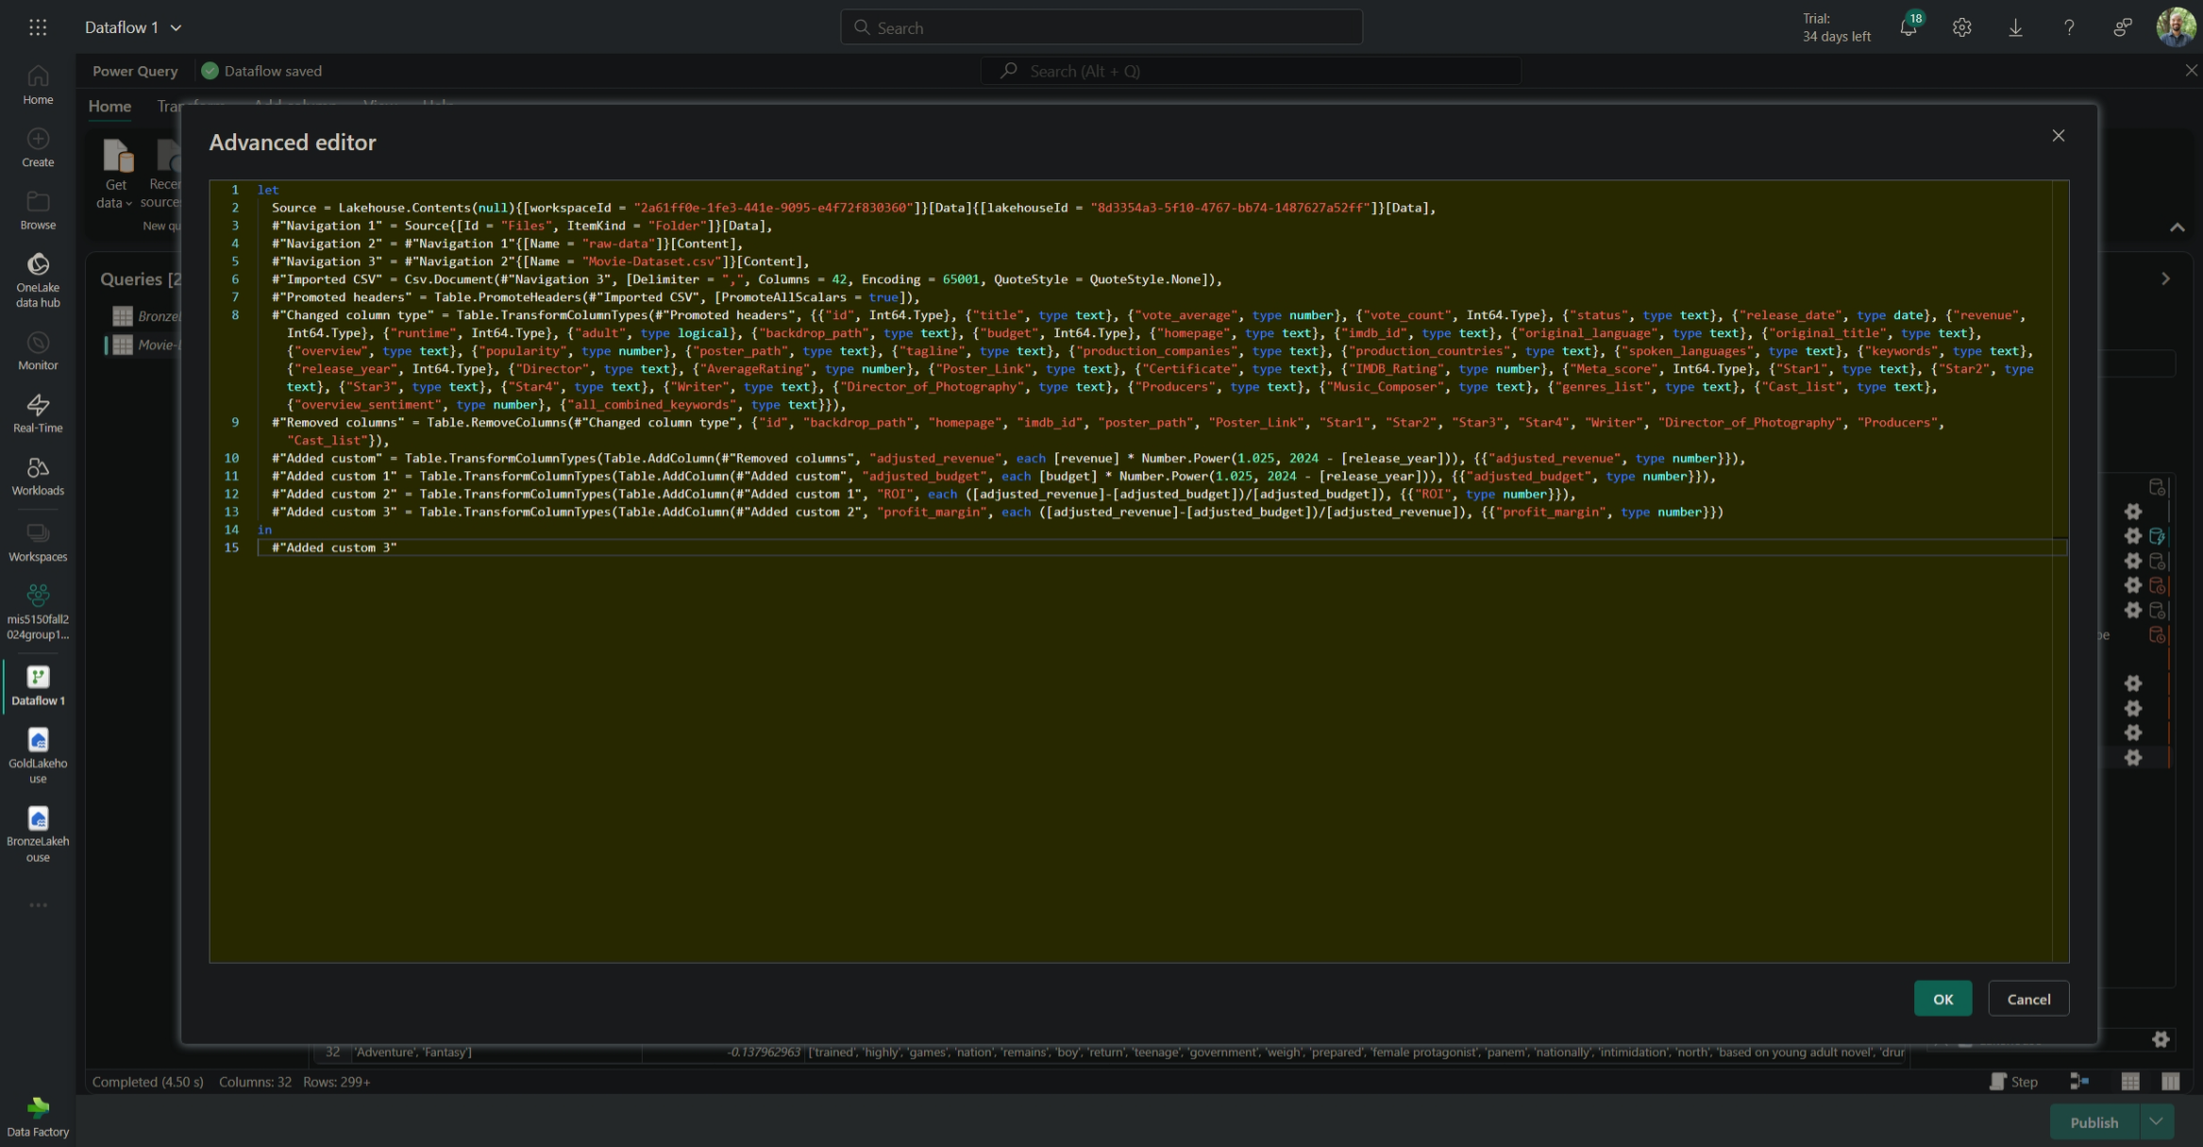
Data Flow
Data in storage container
Shortcut to data in bronze lakehouse
Data flow with Power Query transformations to gold lakehouse
SQL endpoint connection from Power BI
Notes:
Praj/Mike

Slide 9
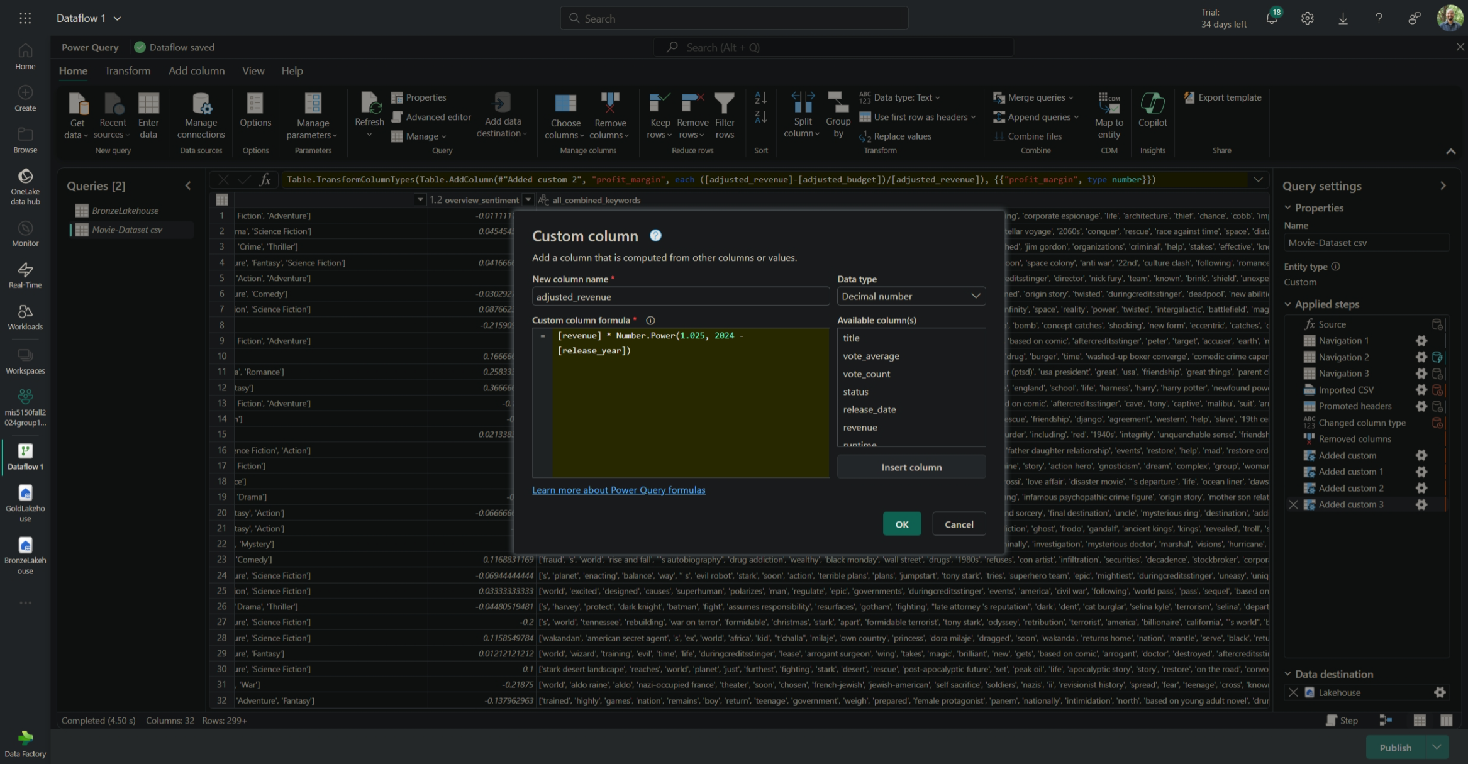
Data Flow
Adjusted revenue calculation to account for estimated inflation
Similar procedure for adjusted budget calculation
Notes:
Praj/Mike

Slide 10
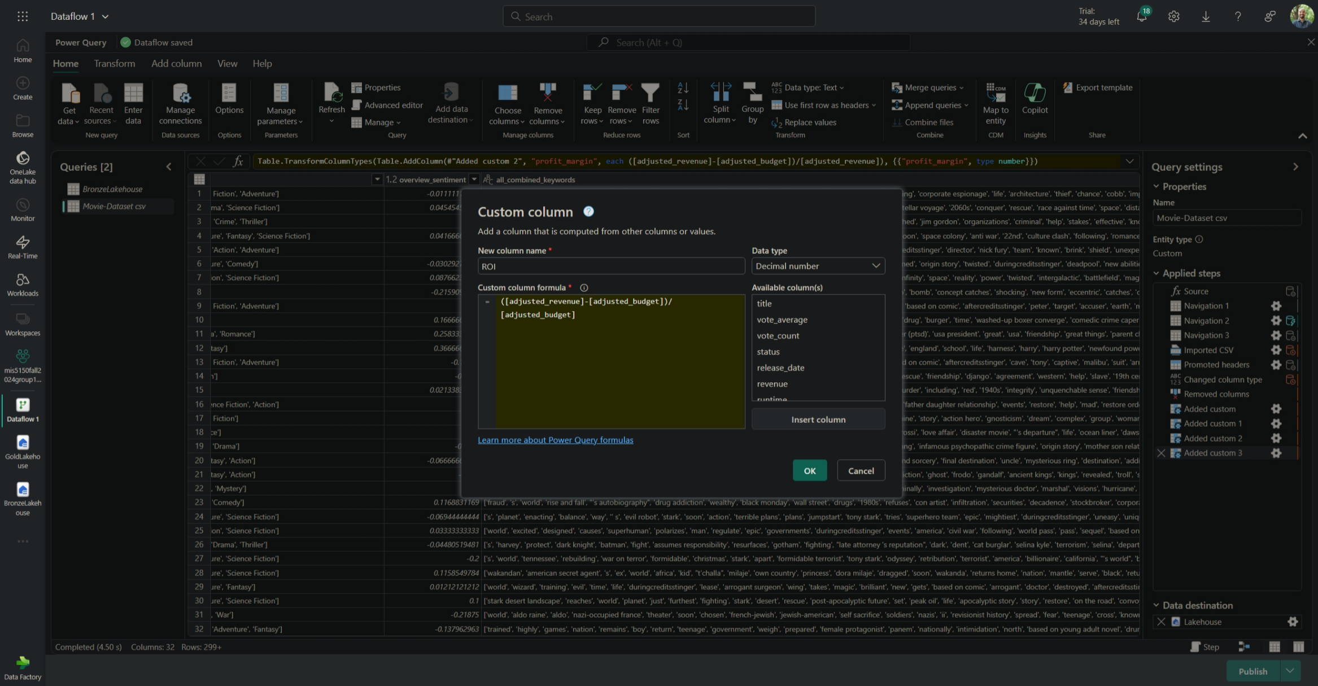
Data Flow
Return on investment (ROI) calculation
Similar procedure for profit margin calculation
Notes:
Praj/Mike

Slide 11

Sentiment Analysis
Categorizing Sentiment Score
Based on the existing sentiment score, a separate column was created.
−1 → Disastrous
+1 → Masterpiece
Advanced Sentiment Analysis
"JMP Pro 17 was utilized for analyzing sentiment values.“
Identify word-level sentiment impact.
Title | Overall sentiment | Sentiment
Inception | -0.011111111 | Bad
Deadpool | -0.030292723 | Bad
Inglourious Basterds | -0.21875 | Disappointing
Parasite | 0.3 | Enjoyable
Kill Bill: Vol. 1 | -0.5625 | Terrible
Get Out | 0.116666667 | Mildly Entertaining
The Imitation Game | 0.7 | Great
Zootopia | 0.25 | Enjoyable
Incredibles 2 | 0.666666667 | Great
Sword of Vengeance | -0.9375 | Disastrous

Slide 12
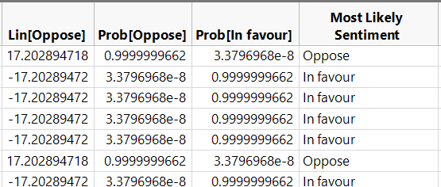
Building a Predictive Model
Analyzed frequently used words to understand their influence on sentiment.
Created a logistic regression model using 100 randomly selected movies.
Classified sentiment into two categories:
In Favor: Positive emotional.
Opposed: Negative emotional.
Title | words
Inception | philosophy skilled kidnapping manipulation mission person "target s subconscious" implantation rescue infiltrating corporate espionage life architecture thief chance cobb impossible task dream payment inception spy considered heist California regain old subconscious France Paris idea target offered "person idea" allegory airplane memory virtual reality car crash los Angeles commits targets world

Slide 13
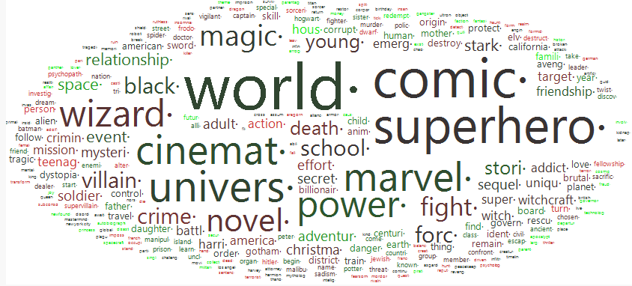
Sentiment Analysis: Word Cloud
A dataset of 100 randomly selected movies was fed into the software (JMP Pro 17) for analysis.
Used the Text Explorer feature to identify the most frequently used words

Slide 14
Sentiment Analysis: Insights
Title | Year | Rating | Sentiment
12 Angry Men | 1957 | 9 | Bad
Fight Club | 1999 | 8.8 | Disappointing
Inception | 2010 | 8.8 | Bad
Inglourious Basterds | 2009 | 8.3 | Disappointing
It | 2017 | 8.1 | Disappointing
Joker | 2019 | 8.5 | Disappointing
Kill Bill: Vol. 1 | 2003 | 8.1 | Terrible
Memento | 2000 | 8.4 | Bad
Pirates of the Caribbean: At World's End | 2007 | 8.2 | Bad
Prisoners | 2013 | 8.1 | Bad
Saving Private Ryan | 1998 | 8.6 | Disappointing
Se7en | 1995 | 8.6 | Bad
Shutter Island | 2010 | 8.2 | Terrible
The Godfather | 1972 | 9.2 | Disappointing
The Pianist | 2002 | 8.5 | Bad
The Prestige | 2006 | 8.5 | Bad
Best-rated movies often had low sentiment scores
High ratings don’t always indicate positive emotional responses.
Low-rated movies showed higher sentiment scores
They could still evoke positive emotional engagement despite low overall ratings.

Slide 15
Sentiment Analysis: Insights
Title | Year | Rating | Sentiment
Spider-Man: Far From Home | 2019 | 6.7 | Enjoyable
Ready Player One | 2018 | 6.8 | Mildly Entertaining
Top Gun | 1986 | 5.7 | Enjoyable
Luca | 2021 | 6.3 | Enjoyable
The Terminal | 2004 | 6.8 | Enjoyable
Cars 2 | 2011 | 6.3 | Enjoyable
300: Rise of an Empire | 2014 | 6.9 | Mildly Entertaining
Kung Fu Panda 3 | 2016 | 6.2 | Mildly Entertaining
Cars 3 | 2017 | 5.3 | Mildly Entertaining
Five Feet Apart | 2019 | 6.3 | Enjoyable
Some low-rated movies displayed strong positive sentiment
Emotional connections that high ratings don’t always capture.
High-rated movies often lacked strong sentiment
Possibly due to expectations, critic bias, or other external factors beyond emotional engagement.

Slide 16
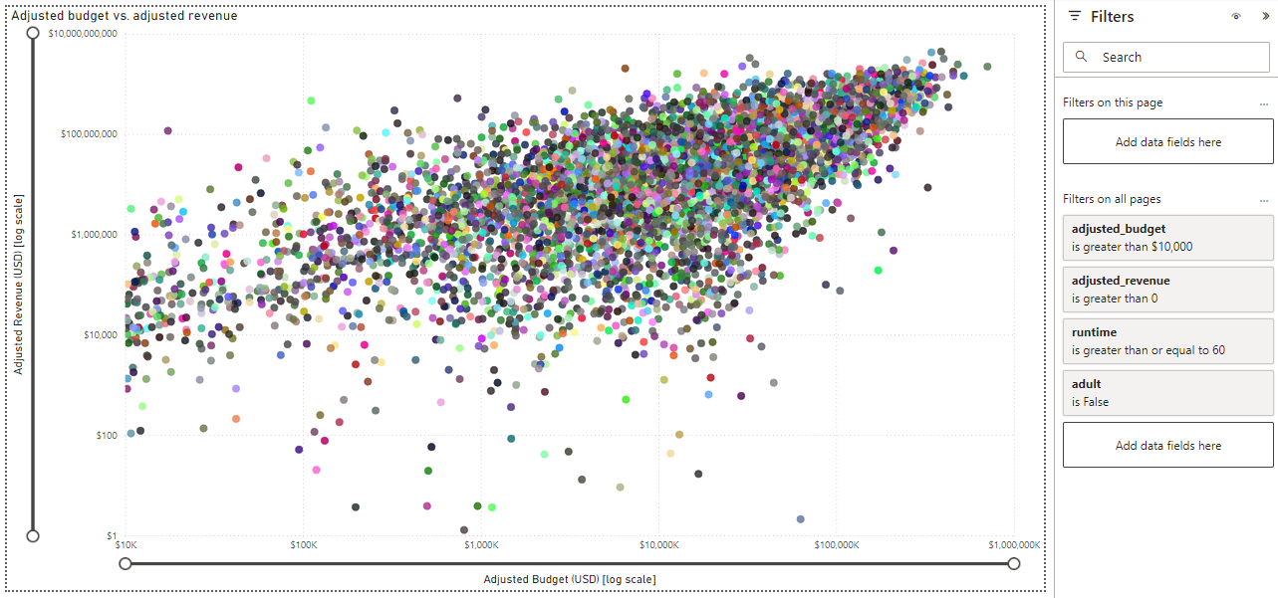
Power BI Visualization
From complex…
Adjusted budget vs. adjusted revenue (log scale)

Slide 17
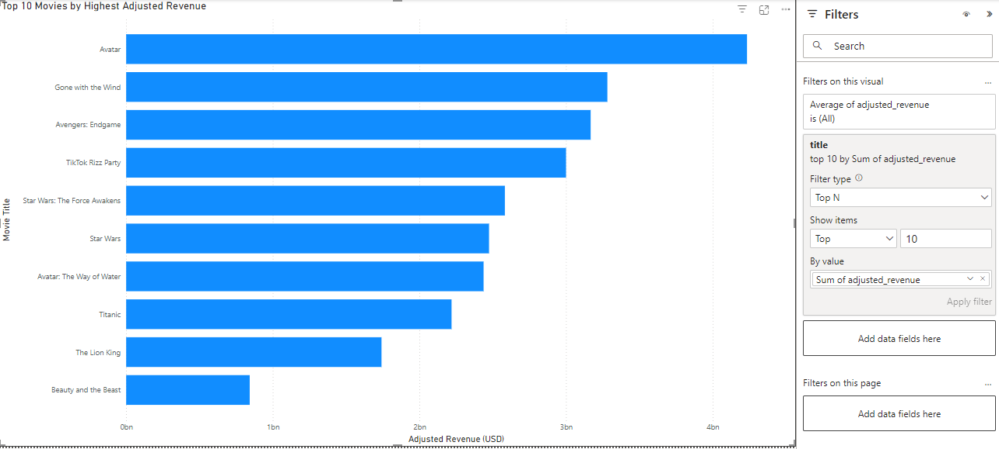
Power BI Visualization
… to simple
Top 10 Movies by Highest Adjusted Revenue

Slide 18
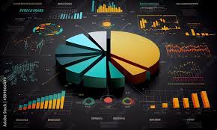
Conclusion
Strong Insights on Movie Dataset
Application of Big Data Techniques
Visualization for Analysis
Presentation Skills

Slide 19
Thank You!
Questions?

